Slide 1
KL UNIVERSITY • BACHUPALLY CAMPUS, HYDERABAD
Department of Computer Science & Engineering
Credit Card Fraud Detection
Existing credit card fraud detection systems often struggle to detect new and complex fraud patterns, especially with highly imbalanced transaction data.
PRESENTED BY
UNDER THE GUIDANCE OF
2520030575 M. Likhitha
2520030198 K. Vaishnavi
Dr. Raghavendra
Designation, Department of CSE
KLH Bachupally Campus
B.Tech II Year | Minor Project - Review 1 | Academic Year 2026-27 | Date: 19-09-2026
Notes:
Model template - Minor Project review presentation for B.Tech II year. Replace every placeholder in angle brackets. Title slide: speak for 30 seconds - greet the panel, state the title, introduce the team and the guide. Do not read the slide word for word.

Slide 2
AGENDA
Contents
1
Introduction & Domain Background
7
Methodology & Modules
2
Problem Statement & Motivation
8
Tools and Technologies
3
Literature Survey
9
Work Completed / Demo
4
Research Gap Identified
10
Timeline & Review Plan
5
Objectives of the Project
11
Expected Outcome & Conclusion
6
Proposed System Architecture
12
References
Dept. of CSE | KL University, Bachupally Campus
2
Notes:
Keep the agenda to one slide. In a 10-12 minute review, spend the most time on literature survey, objectives and work completed.

Slide 3
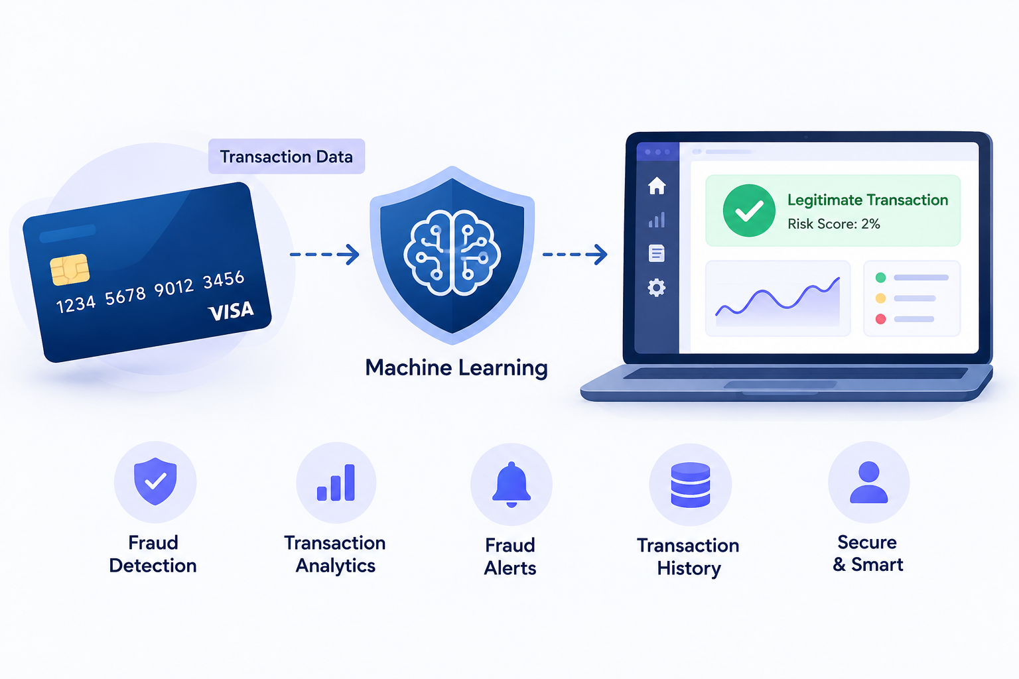
SECTION 1
Introduction & Domain Background
[ Insert a domain image, chart
or concept illustration here ]
What is the domain?
Domain: FinTech & Cybersecurity
Credit card fraud detection uses machine learning to identify suspicious and unauthorized transactions.
Why is it relevant today?
The growth of digital payments has increased the need for fast and reliable fraud detection to protect users and financial institutions.
Where does your project sit?
Credit Card Fraud Detection uses machine learning to analyse transaction patterns and classify transactions as legitimate or fraudulent, with a frontend dashboard for monitoring and analysis.
Panel tip
Our project combines Machine Learning + Python Backend + Interactive Frontend to detect suspicious credit card transactions and provide quick, data-driven fraud analysis.
Dept. of CSE | KL University, Bachupally Campus
3
Notes:
60-90 seconds. Start broad (the domain), end narrow (your specific task). Avoid definitions copied from Wikipedia - the panel will ask for the source.

Slide 4
SECTION 2
Problem Statement & Motivation
PROBLEM STATEMENT
Existing fraud detection systems may fail to identify new and complex fraud patterns because they mainly rely on traditional methods, which can result in missed fraudulent transactions.
1
2
3
Who is affected?
What is the cost of the problem?
Why solve it now?
Financial losses, stolen money, and loss of customer trust due to undetected fraudulent transactions.
Online transactions are increasing, so credit card fraud is also increasing. Early detection can reduce financial losses and protect customers.
Credit card users and banks are affected because undetected fraud can cause financial loss and security risks
Dept. of CSE | KL University, Bachupally Campus
4
Notes:
The problem statement must be ONE sentence. If you need two sentences, the scope is too wide for a minor project. The panel's first question is usually: who exactly benefits?

Slide 5
SECTION 3
Literature Survey
S.No | Author & Year | Title / Technique Used | Dataset / Tools | Key Findings | Limitation / Gap
1 | Dal Pozzolo et al. (2017) | Credit Card Fraud Detection – Machine Learning | Real-world credit card transactions | ML can effectively detect fraudulent transactions and handle highly imbalanced data. | Fraud patterns change over time, making continuous adaptation difficult.
2 | Carcillo et al. (2018) | SCARFF – Real-Time Fraud Detection using ML, Spark | Real-world streaming transactions; Kafka, Spark, Cassandra | Supports near real-time fraud detection and handles large transaction streams and class imbalance. | Requires complex Big Data infrastructure, which may be unnecessary for smaller systems.
Dept. of CSE | KL University, Bachupally Campus
5
Notes:
Do not read the table aloud. Speak about the trend: what most papers did, what results they reached, and what all of them left unsolved. Row 1 is a worked example - delete it and put your own paper there.

Slide 6
SECTION 3
S.No | Author & Year | Title / Technique Used | Dataset / Tools | Key Findings | Limitation / Gap
3 | Fiore et al. (2019) | GAN-based Fraud Detection | Credit card transaction dataset; GAN + classifier | Generated minority-class samples improved fraud detection, especially sensitivity. | GAN-based methods are more complex and computationally demanding
4 | Raghavan & El Bialy (2020) | Deep Learning Methods for Credit Card Fraud Detection | 3 financial datasets; ML & Deep Learning | Deep learning methods showed strong performance compared with traditional ML methods. | Deep learning can require more computational resources and complex tuning..
Dept. of CSE | KL University, Bachupally Campus
5
Notes:
Do not read the table aloud. Speak about the trend: what most papers did, what results they reached, and what all of them left unsolved. Row 1 is a worked example - delete it and put your own paper there.

Slide 7
SECTION 3
S.No | Author & Year | Title / Technique Used | Dataset / Tools | Key Findings | Limitation / Gap
5 | Van Houdt et al. (2020) | Autoencoder-based Fraud Detection | Benchmark credit card dataset | utoencoder reduced transaction features and improved fraud classification performance. | The approach is more complex than basic ML models.
Dept. of CSE | KL University, Bachupally Campus
5
Notes:
Do not read the table aloud. Speak about the trend: what most papers did, what results they reached, and what all of them left unsolved. Row 1 is a worked example - delete it and put your own paper there.

Slide 8
SECTION 4
Research Gap Identified
GAP 1
Existing fraud detection methods may struggle with highly imbalanced transaction data, where fraudulent transactions are very few compared to legitimate ones.
OUR PROJECT ADDRESSES
GAP 2
Our Credit Card Fraud Detection system addresses these gaps by combining Machine Learning-based fraud detection with an interactive dashboard for real-time analysis, alerts, transaction history, and analytics.
Many existing methods focus mainly on detection accuracy and do not provide an easy-to-use interface for monitoring fraud.
GAP 3
Few systems combine machine learning detection, fraud alerts, transaction history, and analytics in one simple platform.
Dept. of CSE | KL University, Bachupally Campus
6
Notes:
This is the slide that separates a good review from an average one. State 2-3 gaps only, and make sure each one maps to a paper you listed.

Slide 9
SECTION 5
Objectives of the Project
To collect / prepare : To collect and prepare a credit card transaction dataset containing legitimate and fraudulent transactions.
1
To design & implement : To design and implement a Machine Learning model for detecting fraudulent transactions.
2
To evaluate : To evaluate the model based on accuracy, precision, recall, and F1-score.
3
To deploy / demonstrate : To develop and demonstrate an interactive web application for fraud detection, alerts, and transaction analysis.
4
Dept. of CSE | KL University, Bachupally Campus
7
Notes:
Avoid vague verbs - study, understand, analyse. Use build, classify, detect, compare, deploy. Four objectives is the right number for a minor project.

Slide 10
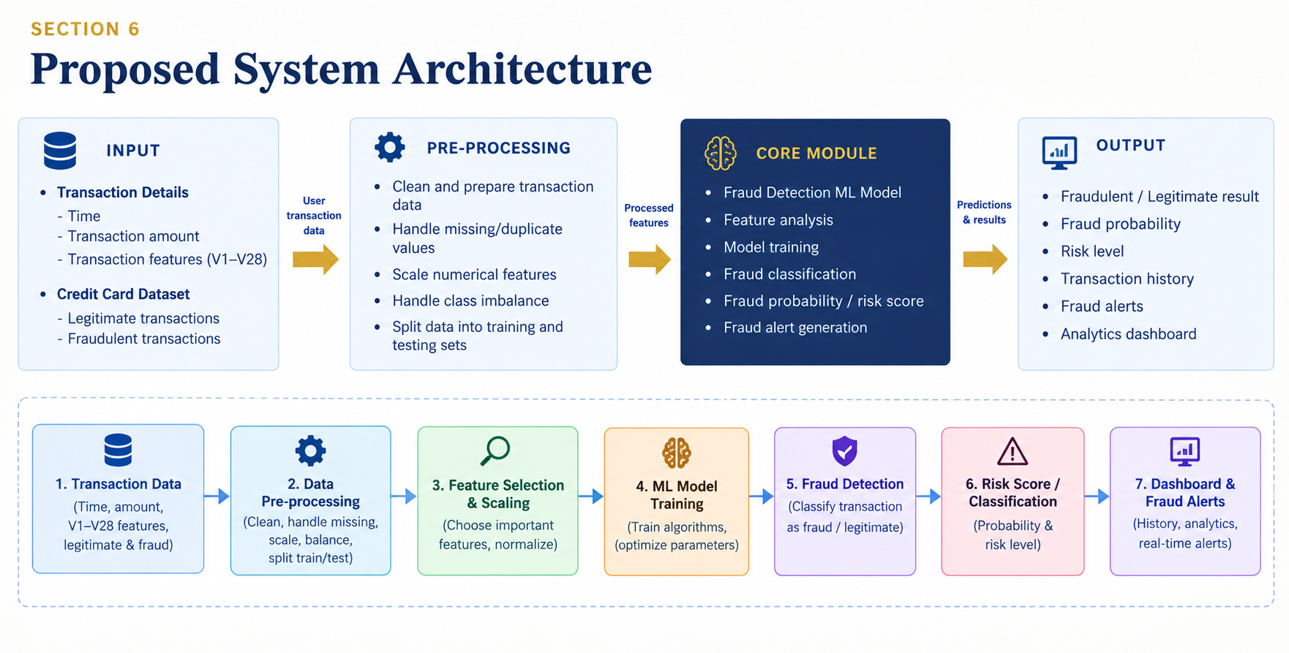
SECTION 6
Proposed System Architecture
INPUT
PRE-PROCESSING
CORE MODULE
OUTPUT
< Cleaning, resizing,
encoding, splitting >
< Model / algorithm
that does the work >
< Prediction shown
in the UI + metrics >
[ Replace this whole row with your own block diagram
(draw.io / Visio / PowerPoint shapes - not a photo of a whiteboard) ]
Label every arrow
Each arrow should say what flows through it - raw image, cleaned CSV, feature vector, JSON response. Unlabelled arrows invite questions you cannot answer.
Dept. of CSE | KL University, Bachupally Campus
8
Notes:
Walk the panel through the diagram left to right in under a minute, naming the input and the output first. Be ready to say where your contribution sits.

Slide 11
SECTION 7
Methodology & Modules
1
Module 1 - Data
2
Module 2 - Processing
Credit card transaction dataset containing transaction time, amount, transaction features (V1–V28), and fraud/legitimate labels. The dataset is divided into training and testing data.
Data cleaning, handling missing values, feature scaling, class balancing, and preparation of data for the ML model.
3
Module 3 - Core Logic
4
Module 4 - Interface
Machine Learning model analyses transaction patterns and classifies transactions as Fraudulent or Legitimate, along with fraud probability/risk score.
Frontend: HTML, CSS, JavaScript
Backend: Python Flask
The user enters transaction details and views fraud results, alerts, transaction history, and analytics through the web dashboard.
Dept. of CSE | KL University, Bachupally Campus
9
Notes:
One module per team member works well - it also answers the panel question 'who did what'.

Slide 12
SECTION 8
Tools and Technologies
SOFTWARE
HARDWARE / PLATFORM
Language: Python 3.11
Libraries: Pandas, NumPy, Scikit-learn, Joblib
Front End: HTML, CSS, JavaScript
Back End: Python Flask
Database: SQLite
IDE: VS Code
Visualization: Chart.js / Matplotlib
Processor: Intel Core i5 or above
RAM: 8 GB minimum
GPU / Cloud: Not required / Google Colab if needed
Deployment: Localhost
Version Control: GitHub
Platform: Windows 11
Dept. of CSE | KL University, Bachupally Campus
10
Notes:
Name versions where you know them. If you have a GitHub repository, show the link here - it is strong evidence of real work.

Slide 13
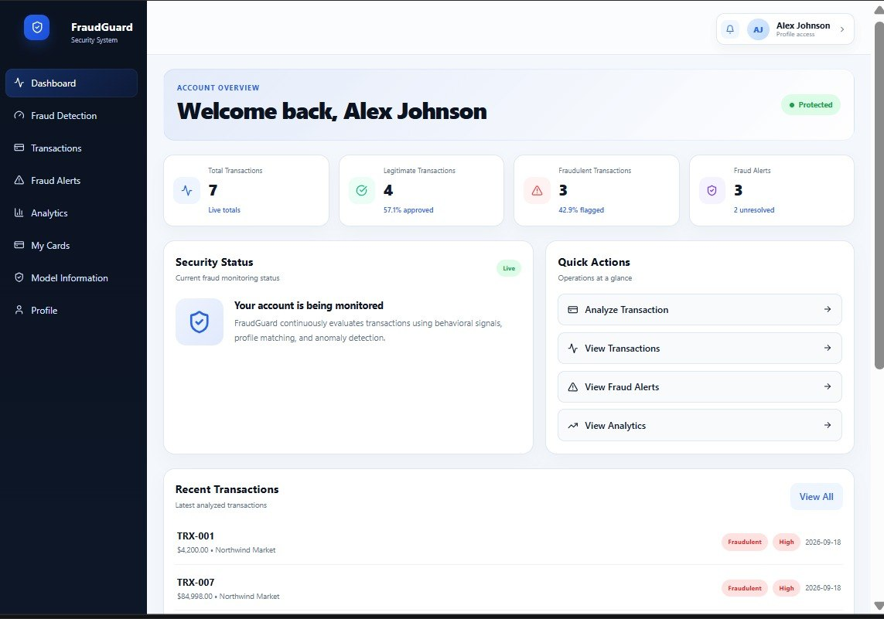
SECTION 9
Work Completed / Demo
Literature survey
Completed
[ Screenshot of your output / UI / code
or a plot of your current results ]
Dataset collection
Completed
Pre-processing pipeline
Completed
Model training
Completed
User interface
In progress
Testing & evaluation
In progress
Dept. of CSE | KL University, Bachupally Campus
11
Notes:
Be honest about status. Panels reward accurate self-assessment and penalise claims that fall apart under one question.

Slide 14
SECTION 10
Timeline & Review Plan
Review 0
Review 1
Review 2
Final
Week 2
Week 5
Week 9
Week 14
Literature survey completed
Dataset collection and exploratory analysis
Pre-processing pipeline developed
System architecture finalized
Model training and tuning
Stream lit interface development
Complete system with all features
Final testing and evaluation
Full demo
Problem understanding and project scope
Dataset selection plan
Team roles finalized
Initial proposal, abstract and objectives
Dept. of CSE | KL University, Bachupally Campus
12
Notes:
Adjust week numbers to your academic calendar. Showing a plan for the remaining weeks is what the panel wants to hear at Review 1.

Slide 15
SECTION 11
Expected Outcome & Conclusion
DELIVERABLE
MEASURABLE TARGET
BEYOND THE LAB
A working web-based Credit Card Fraud Detection System that detects and classifies transactions as fraudulent or legitimate.
Achieve high fraud-detection performance based on accuracy, precision, recall, and F1-score, with fast prediction response.
Can be used by banks and financial institutions to monitor transactions and identify suspicious activities.
CONCLUSION
Our project aims to detect fraudulent credit card transactions using Machine Learning. Existing methods face challenges such as imbalanced data and changing fraud patterns. Our system provides fraud detection, risk analysis, alerts, transaction history, and an interactive dashboard.
Future scope: Real-time transaction monitoring and advanced deep-learning models can be add
Dept. of CSE | KL University, Bachupally Campus
13
Notes:
Do not introduce anything new here. The conclusion restates the problem, the gap and the promise - nothing else.

Slide 16
SECTION 12
References
[1]
A. Dal Pozzolo, G. Boracchi, O. Caelen, C. Alippi and G. Bontempi, "Credit card fraud detection: A realistic modeling and a novel learning strategy," IEEE Transactions on Neural Networks and Learning Systems, vol. 29, no. 8, pp. 3784-3797, 2018.
[2]
F. Carcillo, A. Dal Pozzolo, Y.-A. Le Borgne, O. Caelen, Y. Mazzer and G. Bontempi, "SCARFF: A scalable framework for streaming credit card fraud detection with Spark," Information Fusion, vol. 41, pp. 182-194, 2018.
[3]
M. A. A. M. R. A. J. et al., "Credit card fraud detection using machine learning algorithms," Procedia Computer Science, vol. 165, pp. 631-641, 2019.
[4]
A. Dal Pozzolo, O. Caelen, R. A. Johnson and G. Bontempi, "Calibrating probability with undersampling for unbalanced classification," in Proc. IEEE Symposium Series on Computational Intelligence (SSCI), 2015.
[5]
D. J. Hand, "Classifier technology and fraud detection," Statistical Science, vol. 16, no. 2, pp. 148-156, 2001.
Dept. of CSE | KL University, Bachupally Campus
14
Notes:
Use Google Scholar's 'Cite' option and pick MLA/IEEE, then fix the formatting by hand. Never cite a blog, a YouTube video or a paper you have not opened.

Slide 17
Thank You
Team: <15> | Guide: < Raghavendra> | Dept. of CSE, KLH Bachupally
Notes:
Keep the deck open on the architecture slide during questions - most panel questions point back to it.

